Slide 1
Classes
Lecture # 12
Inheritance

Slide 2
Static Class Members
One copy of class data member is used by all objects of that class
Static data members represents class wide information.
Must be initialized only once
Static member exist even when no object is created.

Slide 3
Public static member can be accessed using scope resolution operator even when no object is created.
To access private or protected static members , a static function is declared.
Static function is called using scope resolution operator when no object is created.
Static member function does not have this pointer as it exists independently of any object.
This pointer refers to specific object.

Slide 4
Inheritance
The capability of a class to derive properties and characteristics from another class is called Inheritance.
One of the most important feature of Object Oriented Programming
It allows user to create a new class (derived class) from an existing class(base class).
The derived class inherits all the features from the base class and can have additional features of its own.

Slide 5
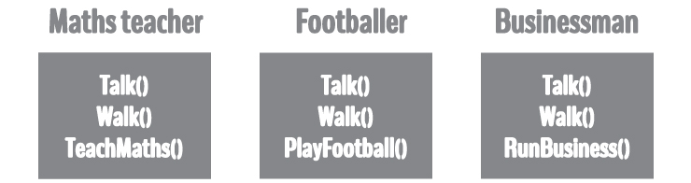
Suppose, in your game, you want three characters - a maths teacher, a footballer and a businessman.
Since, all of the characters are persons, they can walk and talk.
They also have some special skills.
A maths teacher can teach maths, a footballer can play football and a businessman can run a business.
You can individually create three classes who can walk, talk and perform their special skill.

Slide 6
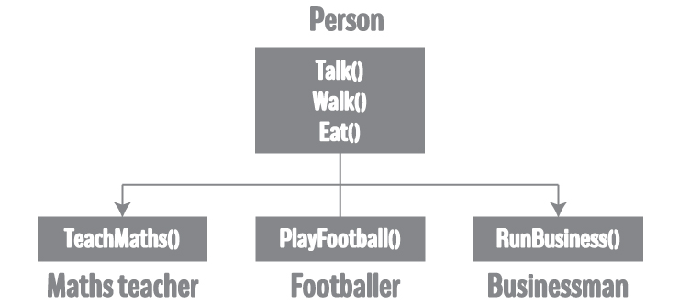
If you want to add a new feature - eat, you need to implement the same code for each character.
This can easily become error prone (when copying) and duplicate codes.

Slide 7
Sub Class: The class that inherits properties from another class is called Sub class or Derived Class.
Super Class: The class whose properties are inherited by sub class is called Base Class or Super class.
Base class is more generic while derived class contains special features.
Classes exists independently, inheritance link them to each other in a hierarchical manner.

Slide 8
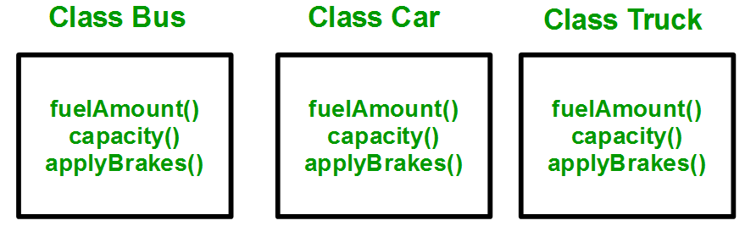

Slide 9
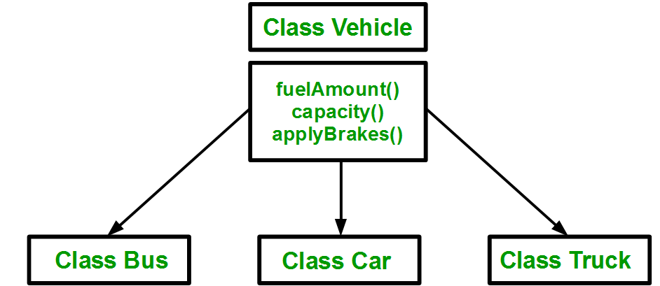

Slide 10
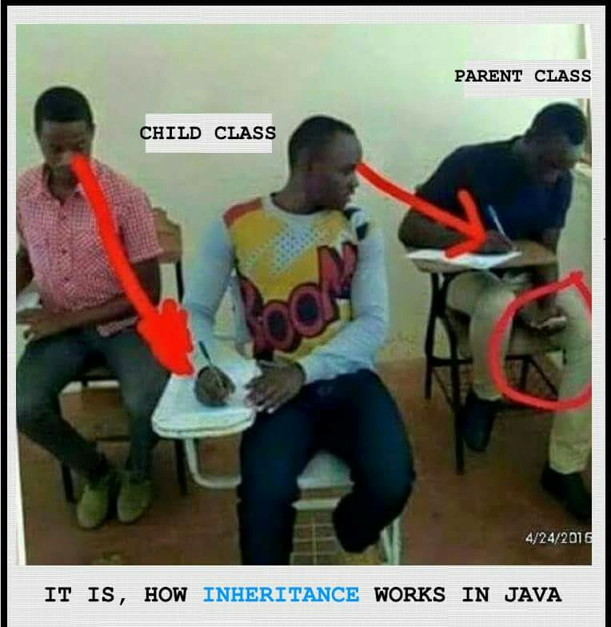

Slide 11
Syntax
class subclass_name : access_mode base_class_name
{
//body of subclass
};
Notes:
Private members of base class are not accessible in derived class no matter what the access mode is. However they are inherited.
Friend functions are not inherited

Slide 12
Constructors and Destructors
Instantiating a derived class begins a chain of constructor calls.
The derived class constructor before performing its own tasks, invokes the constructor of base class and so on.
Destructors are executed in reverse order.
Base class constructors and Destructors are not inherited in the derived class.

Slide 13
Modes of Inheritance
Public mode: If we derive a sub class from a public base class. Then the public member of the base class will become public in the derived class and protected members of the base class will become protected in derived class.
Protected mode: If we derive a sub class from a Protected base class. Then both public member and protected members of the base class will become protected in derived class.
Private mode: If we derive a sub class from a Private base class. Then both public member and protected members of the base class will become Private in derived class.

Slide 14
The private members in the base class cannot be directly accessed in the derived class, while protected members can be directly accessed.

Slide 15
